Slide 1

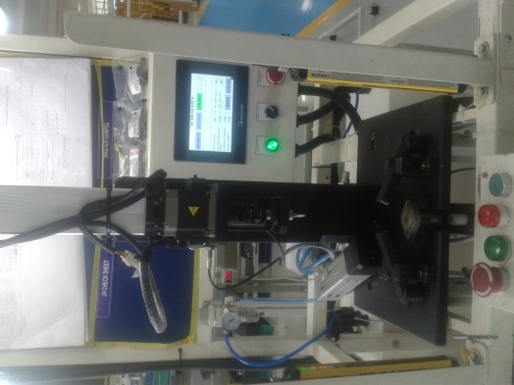
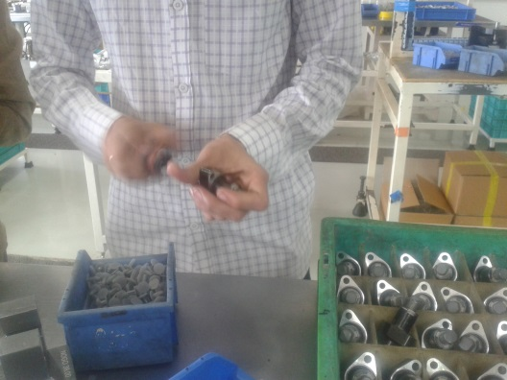
P15
TPM CIRCLE NO :- 3
ACTIVITY
KK
QM
PM
JH
SHE
OT
DM
E&T
KAIZEN IDEA SHEET
TPM CIRCLE NAME : P15 TEAM
LOSS NO. / STEP
DEPT :- Assembly
RESULT AREA
P
Q
DEF :- A
C
D
S
M
CELL :-A136
CELL NAME:- Tensioner Assly
MACHINE / STAGE :- A136 Assembly Line
OPERATION :- Rewinding stage.
KAIZEN THEME : To eliminate customer complaint and reduce operator fatigue at rewinding stage.
IDEA :- To make rewinding in auto mode
COUNTERMEASURE:- Auto rewinding implemented at A136 tensioner assembly.
BENCHMARK
0No.
WIDELY/DEEPLY:-
TARGET
12.7.2016
KAIZEN START
PROBLEM / PRESENT STATUS :- Manual rewinding of tensioner.
KAIZEN FINISH
TEAM MEMBERS :-
Bhavesh Pednekar, Vishal Chougule
Sunil Kinkar Sir, Sathe Sir
BENEFITS :-
Prevent occurrence of Customer Complaint.
Reduce COPQ.
KAIZEN SUSTENANCE
BEFORE
AFTER
WHAT TO DO: Daily verify
HOW TO DO: In auto mode
FREQUENCY : 100 %
WHY - WHY ANALYSIS :-
Why1: Operator fatigue and possibility of without rewinding job pass to customer end.
Why 2: Manual rewinding
Why 3: No provision for auto rewinding
RESULT :-
COST INCURRED FOR MAKING KAIZEN
MATERIAL COST
IN RS
LABOUR COST
IN RS
TOTAL COST
IN RS
ROOT CAUSE :- No provision for auto rewinding
------------
-------
---------
SCOPE & PLAN FOR HORIZONTAL DEPLOYMENT
REGISTRATION NO. & DATE: 10.9.16
SR.
NO.
CELL
TARGET
RESPONSIBILITY
STATUS
REGISTERED BY :- Bhavesh Pednekar
---
----
-------
------
------
MANAGER’S SIGN :- Janardan sate

